Slide 1

College Athletics Data Management System
Matthew McDonnell & Zimeng Zhang

Slide 2

CONTENTS
Background
Current Scenario
Goals
Introduction to the system
Improvement

Slide 3


BACKGROUND
Thousands of college soccer players
Millions of aspiring youth soccer players
Hundreds of players transfer schools or take time off (redshirt)
Transfer portal currently, but only compliance and coaches can access
No youth database recruiter that links directly to the NCAA

Slide 4
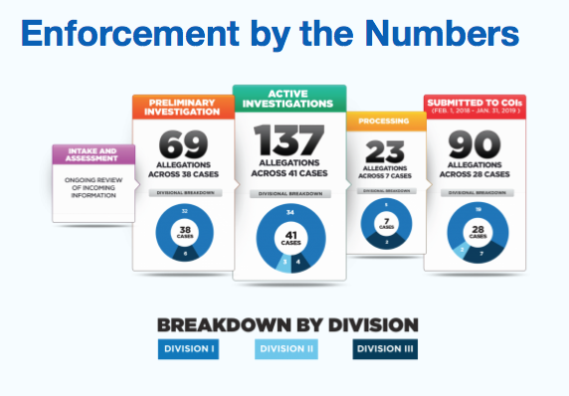
CURRENT SCENARIO
College Soccer Recruitment
Antiquated emailing process
Lack of storage and tracking capabilities
Inconsistent success rate
NCAA Compliance
Eligibility ruling process can be annoying
Little information conveyed in real time to all parties

Slide 5
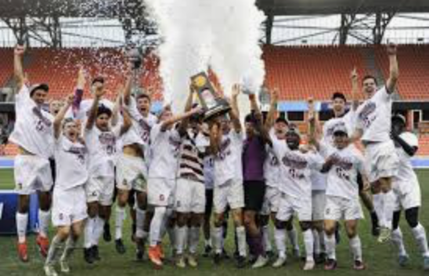
GOALS
Athlete & coach can input attributes and search for criteria
Store basic athlete information
Separate athletes based on eligibility status of certain programs
Store standards for college soccer based on division
Coaches and players are paired based on compatibility

Slide 6
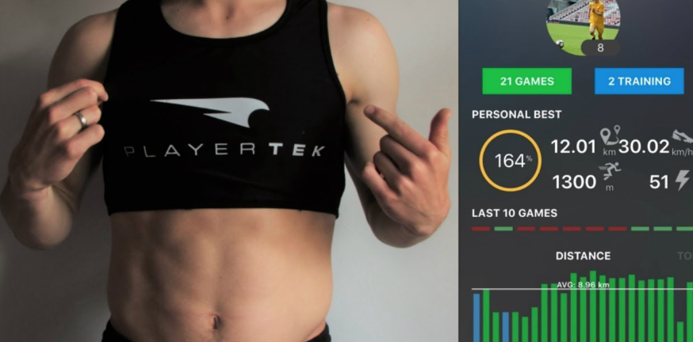
POTENTIAL PROGRESSION
Athletes continue to use while in college
Fitness Load Tracking
Match Stats
Performance Indexes
Academic Performance
Nutritional Awareness/Planning
Coaches use for reflection
Was this recruit type good for the program?
Players of which type were most successful after 4 years?

Slide 7
BUSINESS RULES
Athletes could store their information without eligibility and get comments from coach.
An athlete may get eligibility from different NCAA compliance admins but could only attend one certain sports program.
The NCAA admin decides whether an athlete is eligible for recruitment.
An athlete can be only involved in one recruitment process, while a coach can take part in many recruitment processes with a variety of athletes.
Only athlete who is eligible can attend program provided by University.
Every institution has division from NCAA rules.
Compliance has different levels for each division.
Athletes can have different eligibility IDs based on them taking a redshirt year, leave of absence, or divisional transfer.
Program can have only 1 university but a university can have multiple programs.
A coach can make comments on the potential athletes who do not get eligibility or attend a program and show their compatibility, but a player cannot comment on coaches without being eligibile
Athletes and coaches can have zero or many pairs, but a pair is unique to one and only one player or coach.

Slide 8
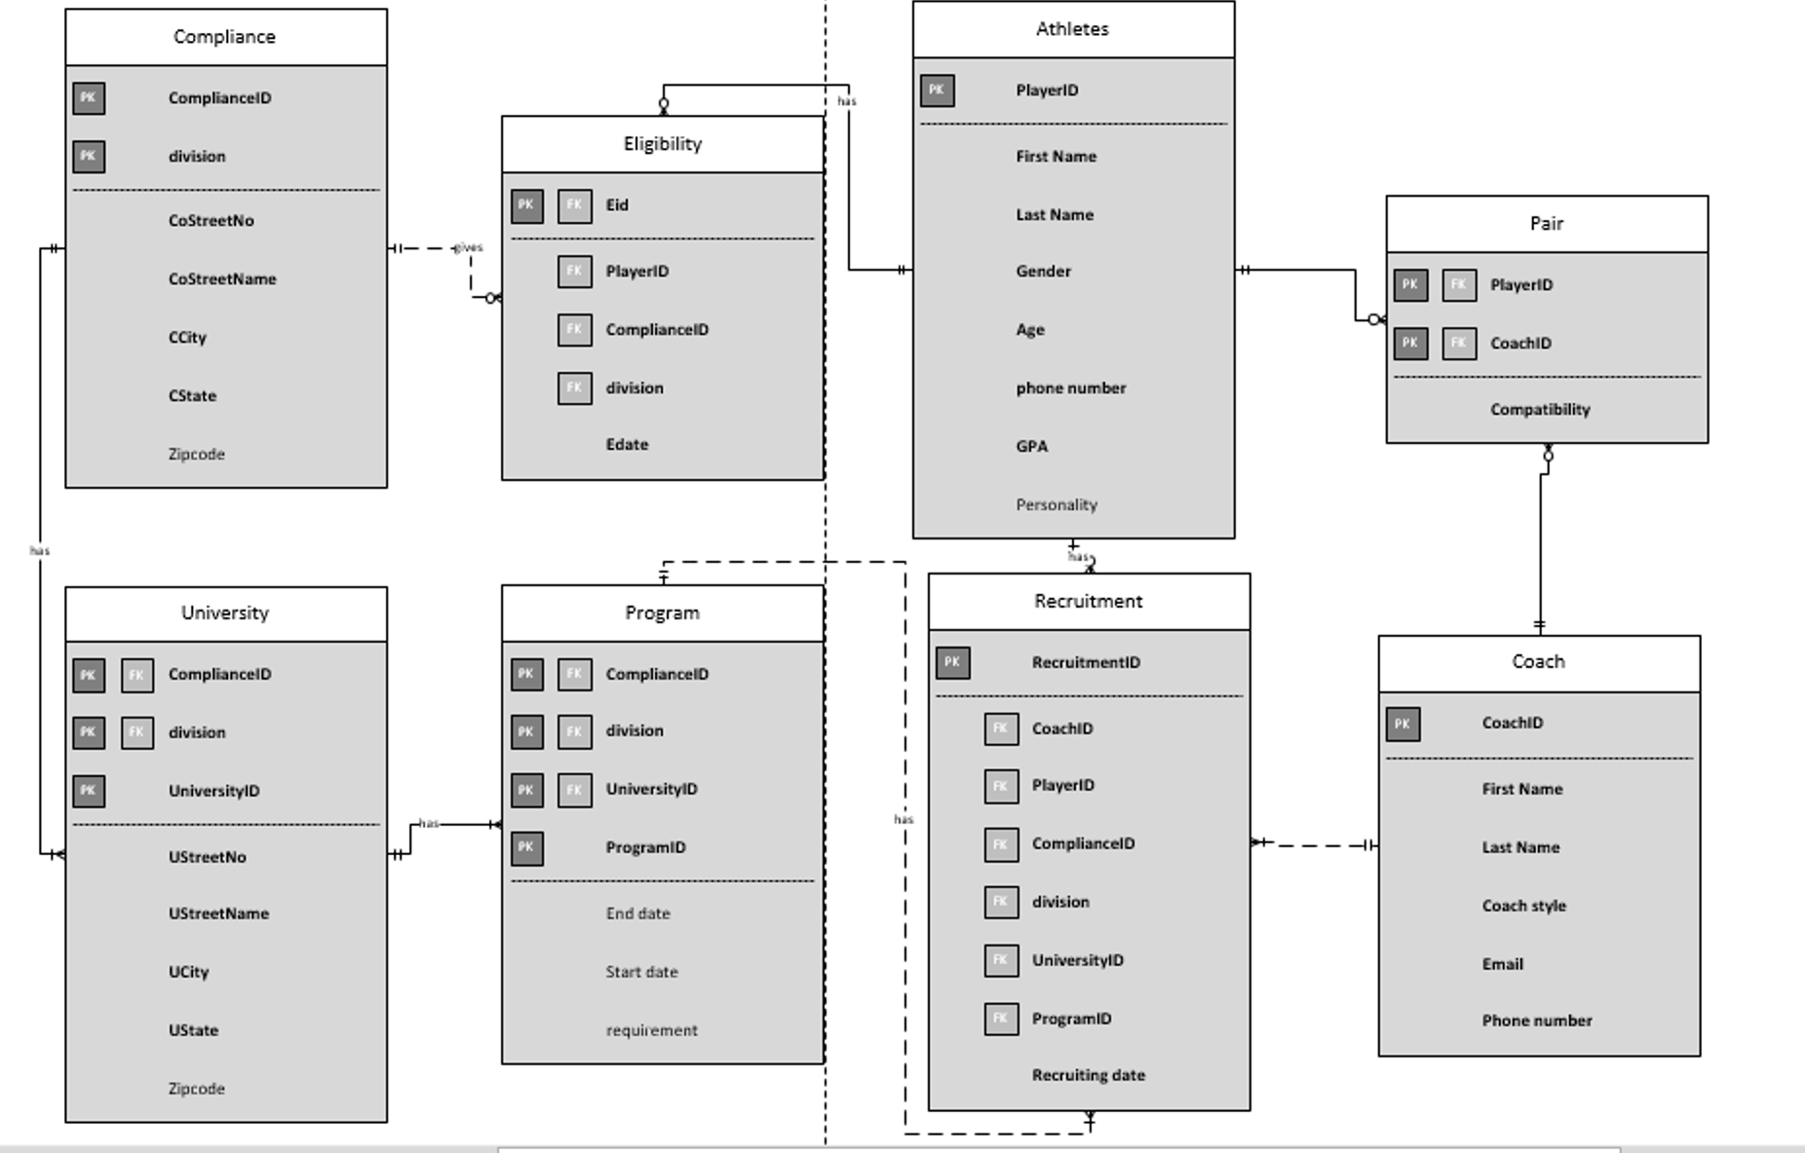
RELATIONAL DATA MODEL

Slide 9
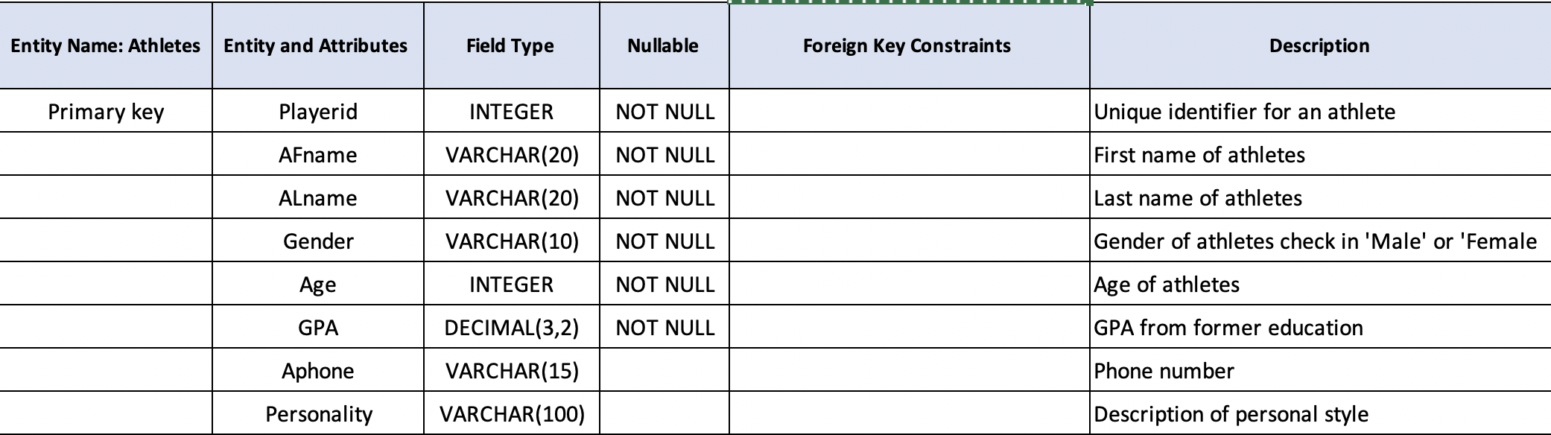
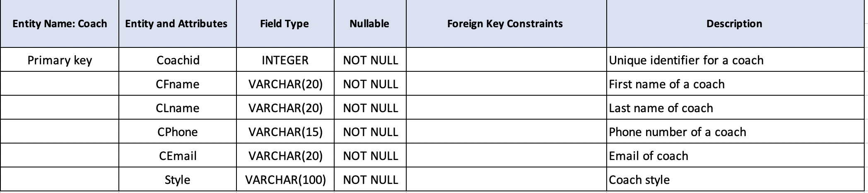
DATA DICTIONARY
Athletes table
Coach table

Slide 10
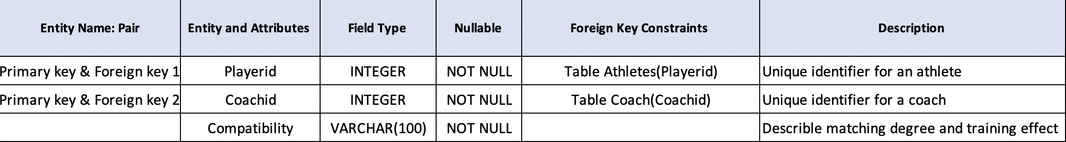
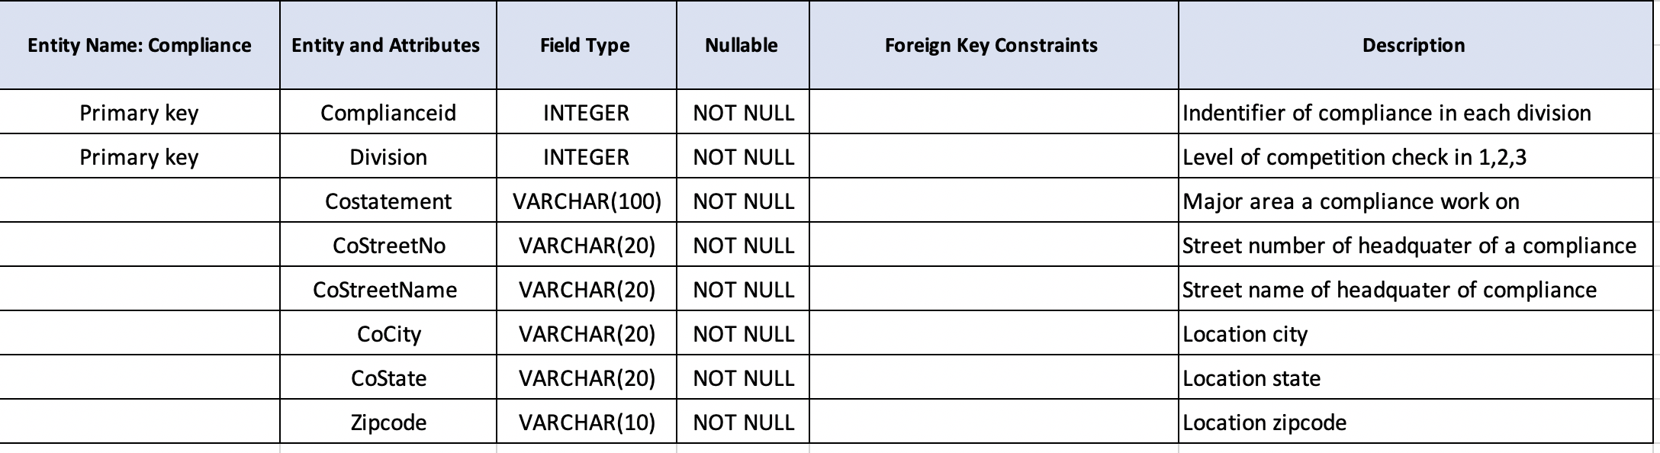
DATA DICTIONARY
Pair table
Compliance table

Slide 11
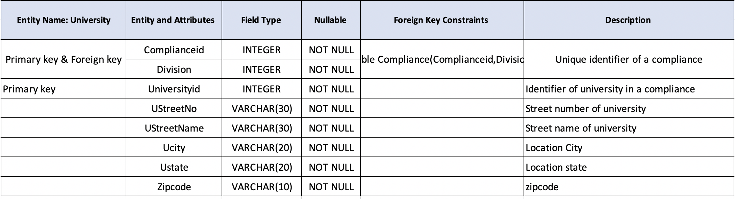
DATA DICTIONARY
University table
Program table

Slide 12
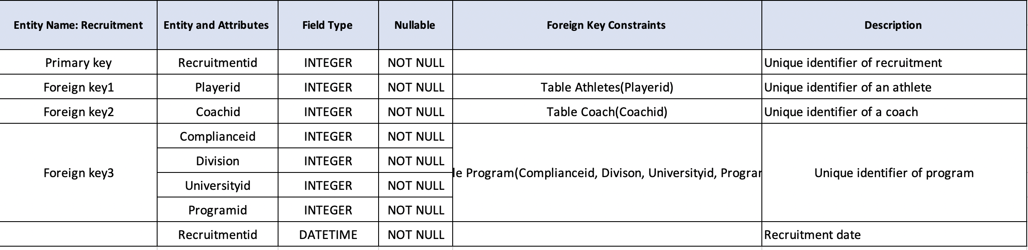
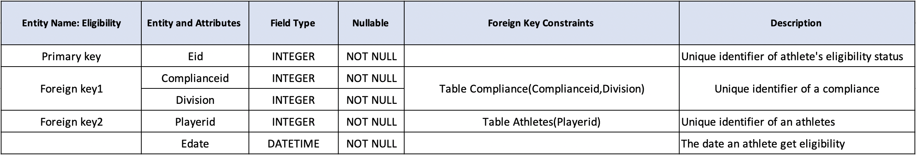
DATA DICTIONARY
Recruitment table
Eligibility table

Slide 13
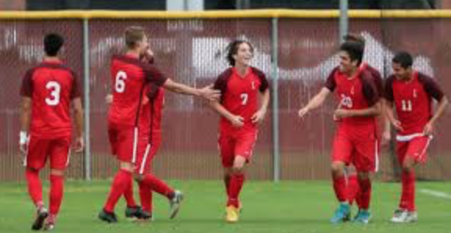
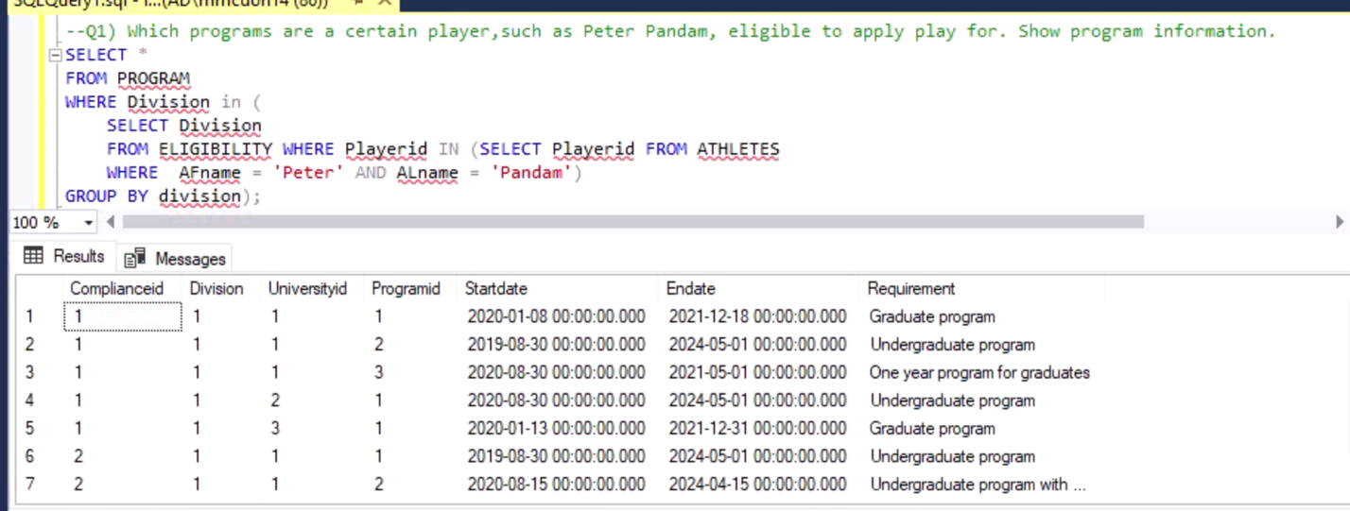
FOR PLAYERS
What are the programs I am eligible for based on my profile?

Slide 14
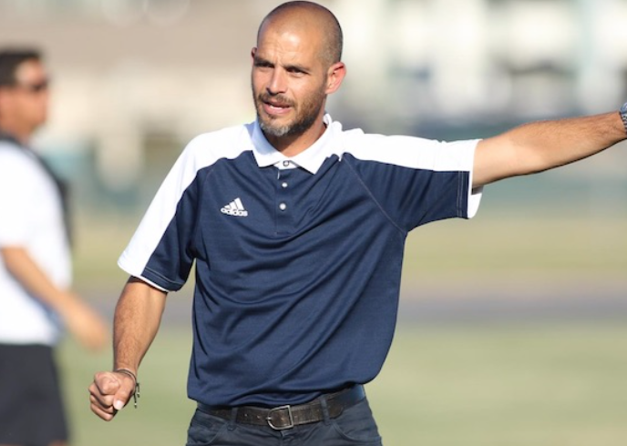
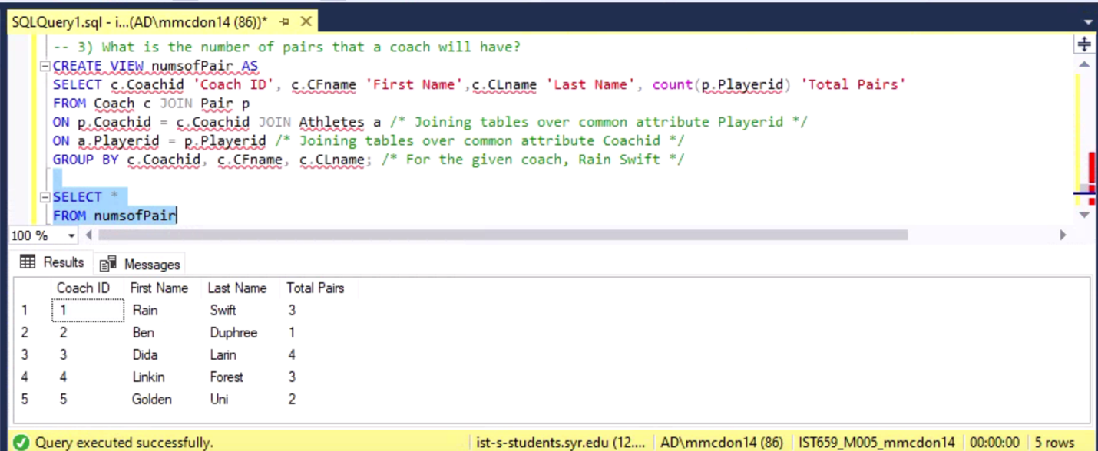
FOR COACHES
How many total pairs does each coach have?

Slide 15

INTERFACE IMPLEMENTATION
FOR ATHLETES, COACHES, & ADMINISTARTORS

Slide 16
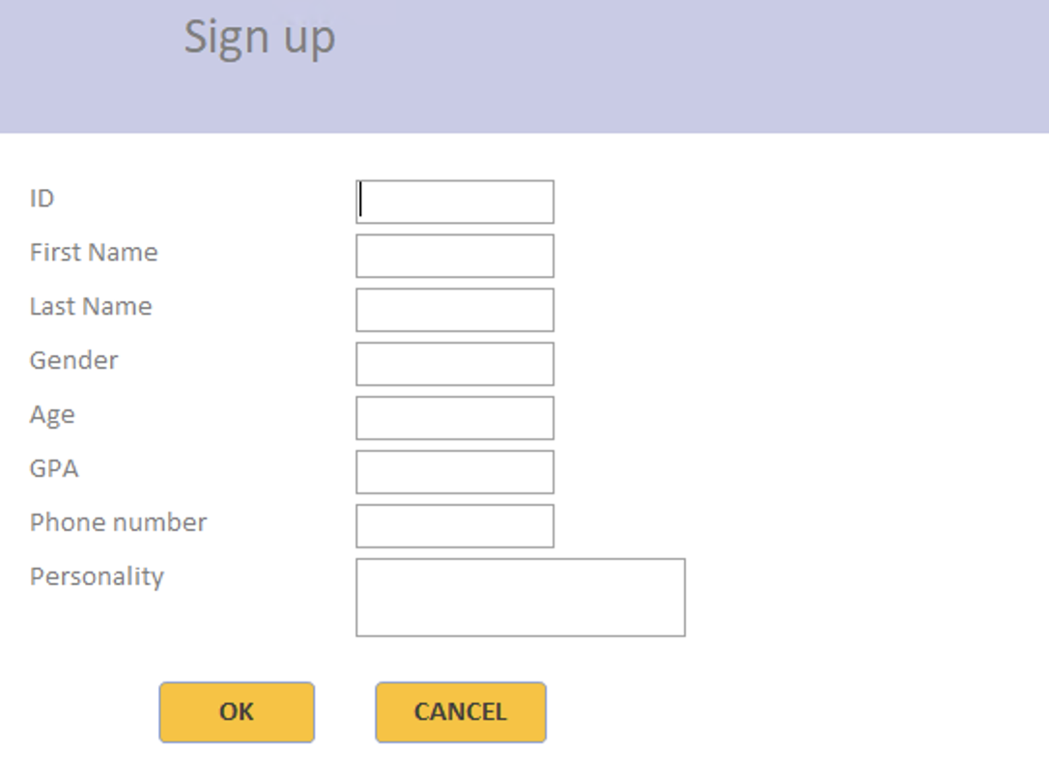
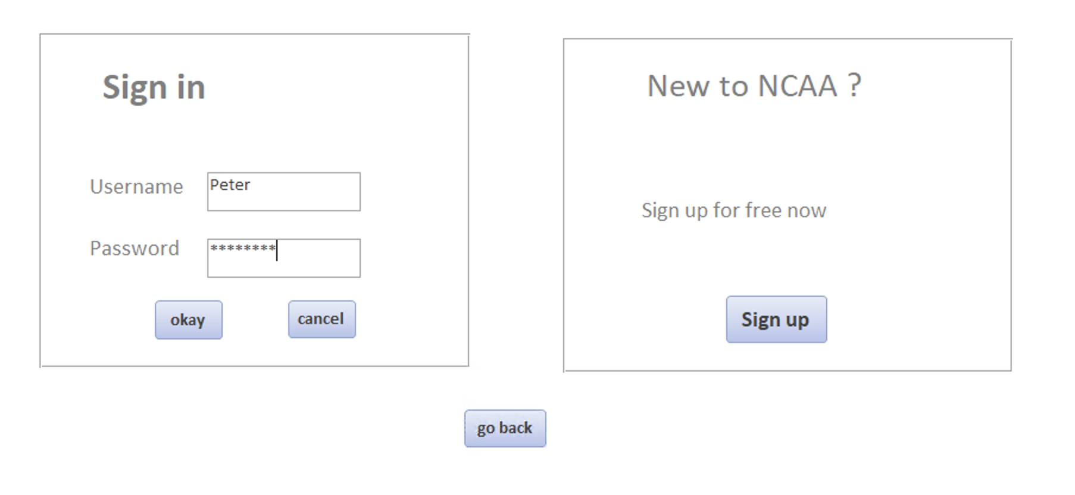
ATHLETE INTERFACE AS AN EXAMPLE
Sign up as a new athlete
Login as Peter

Slide 17
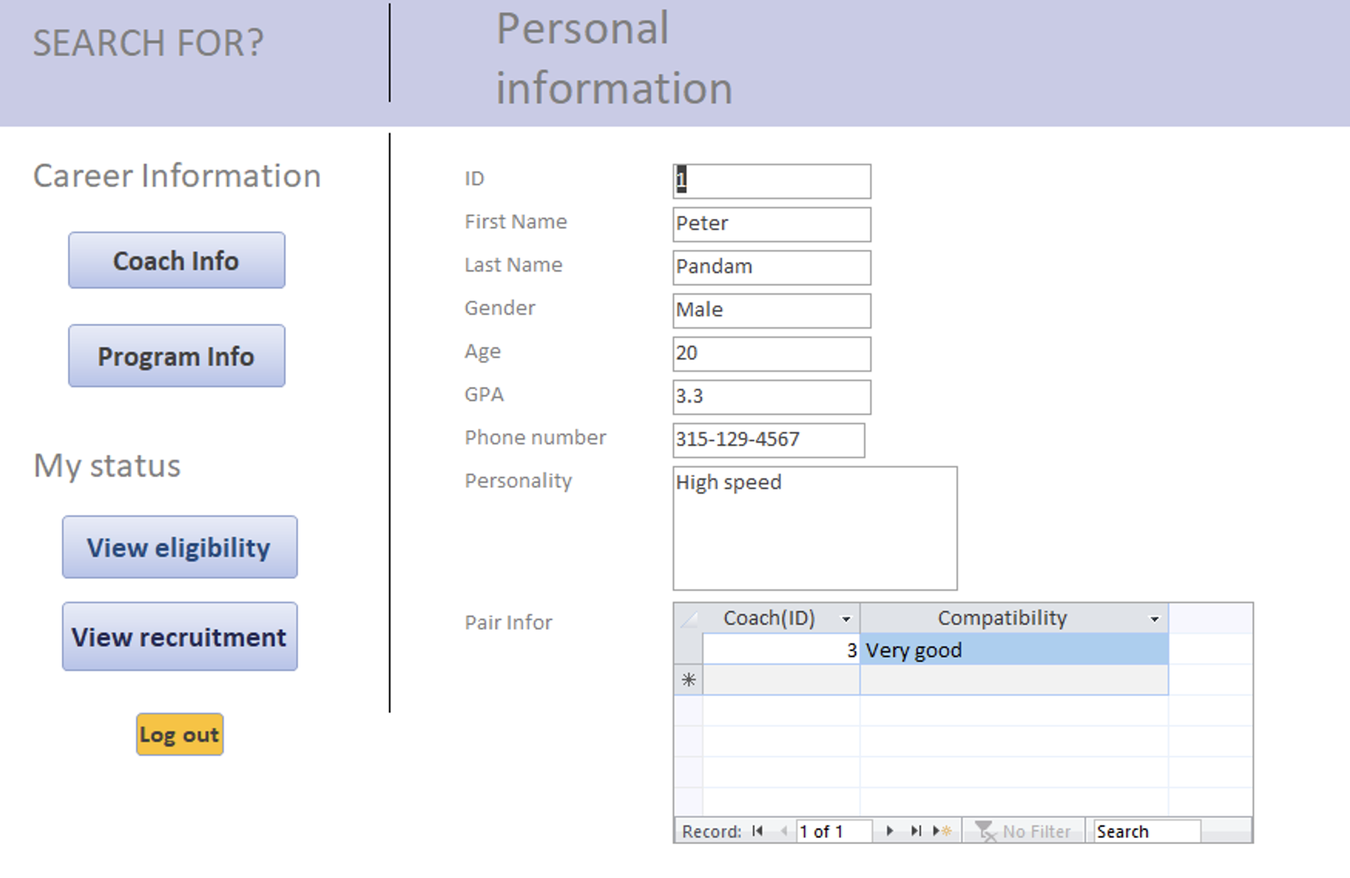
HOMEPAGE

Slide 18
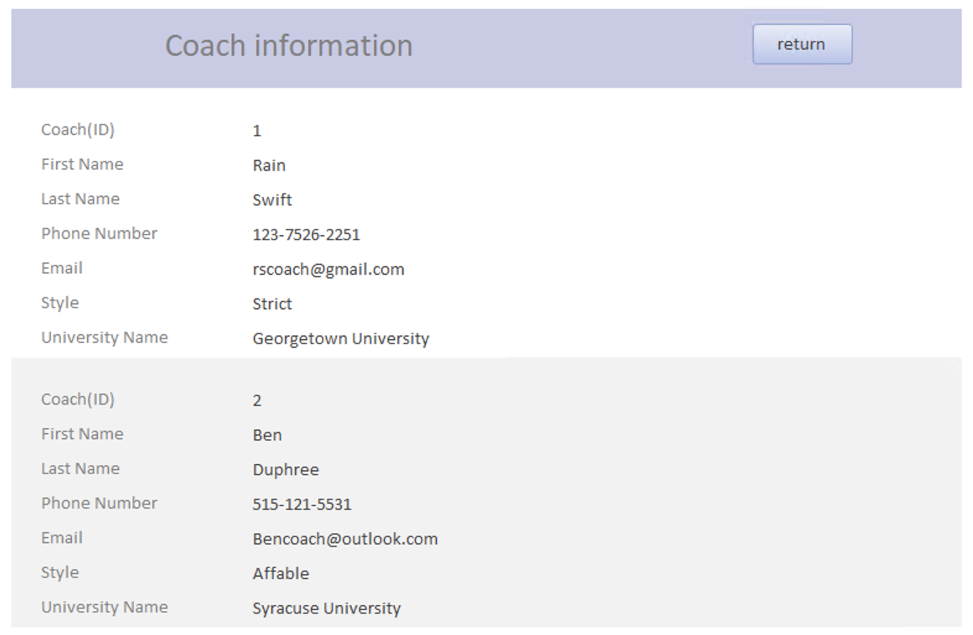
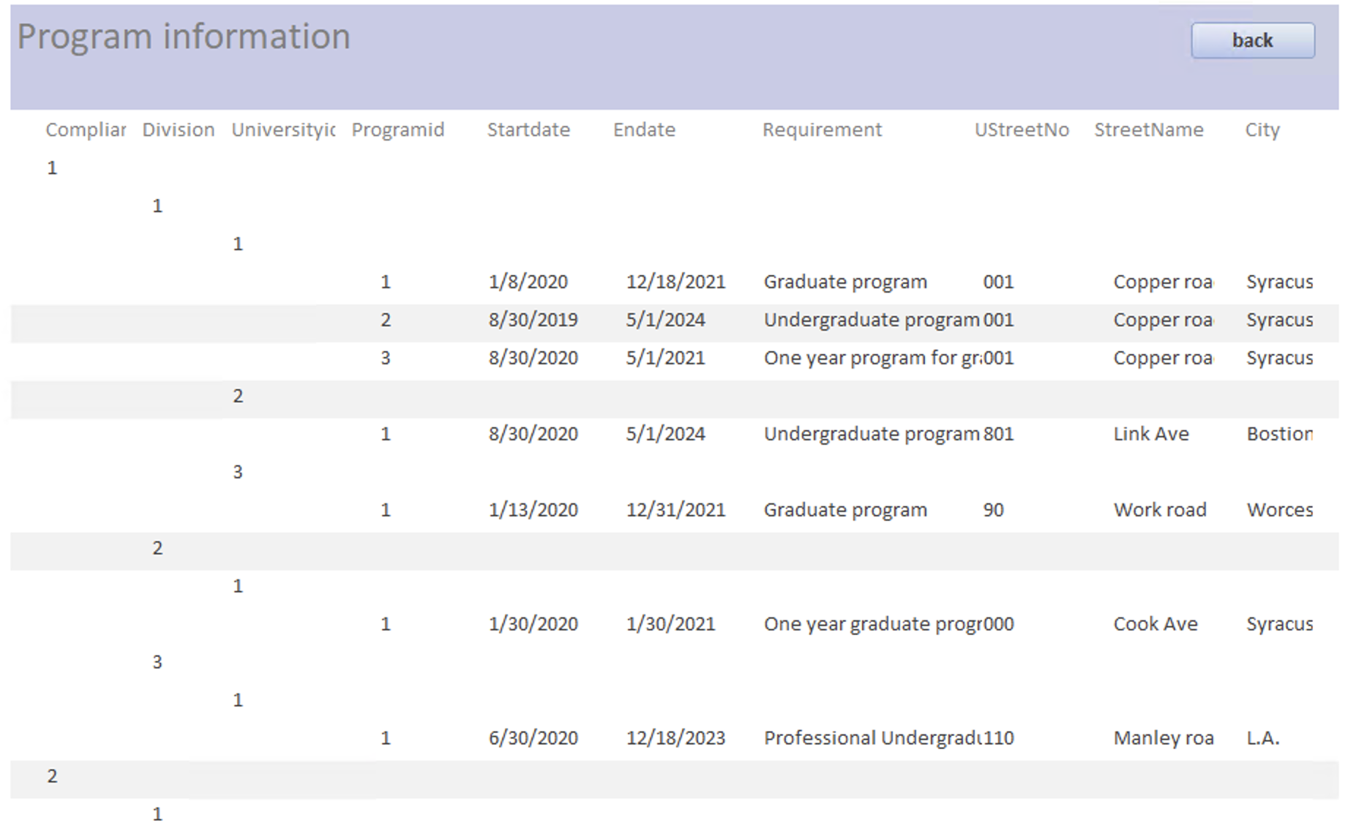
Athlete Informative Forms
View coach information
View program information

Slide 19
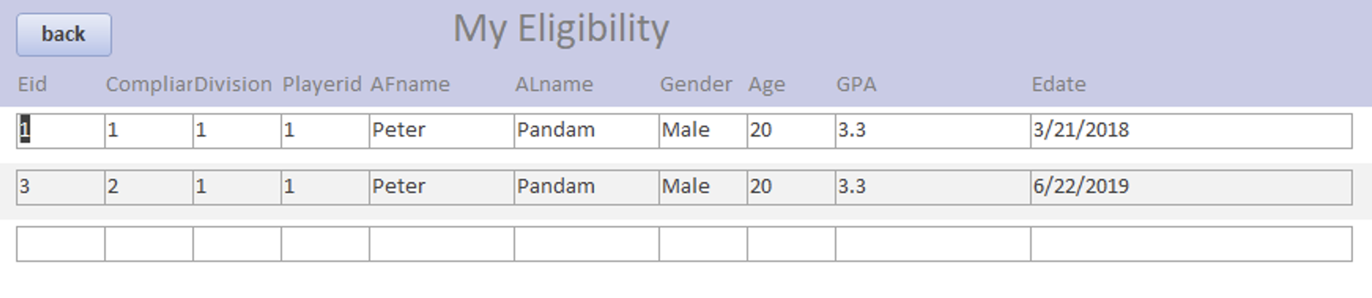
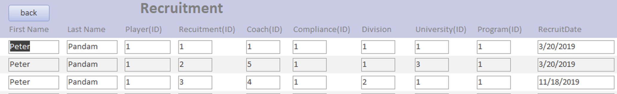
ATHLETE ELIGIBILITY & RECRUITMENT
View eligibility information
View recruitment information

Slide 20

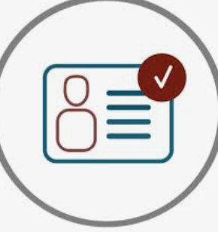
HOW TO IMPROVE THE SYSTEM?
Create password capabilities
Lock certain attributes from being changed by athletes and coaches
Coaches and players cannot update one another’s info
Store useful info for athletes to use past getting recruited

Slide 21

THANK YOU

